Slide 1
INTRUSION DETECTION SYSTEM USING REGULATED PATROLLING ROBOTS FOR APARTMENTS
BY
MOHAMED ASHEIM A,211420104160
NANDHA GOPAL M,211420104175
NIRMAL KUMAR M,211420104183

Slide 3
OBJECTIVE:
The main objective of this project is to design and implement an advanced Intrusion Detection System (IDS) for enhancing apartment security.
The system aims to utilize deep learning algorithms for the identification of known and unknown individuals through camera-based surveillance.
Upon detection of an unknown person, the system triggers a response mechanism, deploying regulated patrolling robots equipped with a microcontroller, motor drive, buzzer, and DC motor for swift and intelligent actions.

Slide 4
ABSTRACT:
In the context of residential security, this project presents an innovative Intrusion Detection System that employs regulated patrolling robots equipped with surveillance cameras and a microcontroller.
The system utilizes deep learning algorithms for the identification of both known and unknown individuals.
Upon detecting an unknown person, the system triggers a sequence of actions, including the activation of a buzzer and the deployment of patrolling robots.
This integration ensures a dynamic and responsive approach to unauthorized access, significantly enhancing apartment security.

Slide 5
INTRODUCTION:
Traditional intrusion detection systems in apartments often rely on static surveillance devices and passive alarms.
These systems face limitations in immediate threat response and the ability to differentiate between known and unknown individuals.
In response to these challenges, the proposed system leverages deep learning for person identification through cameras mounted on regulated patrolling robots.
The microcontroller, buzzer, DC motor, and motor drive facilitate a swift and intelligent response to detected intrusions, marking a paradigm shift in residential security.

Slide 6
LITERATURE SURVEY
In October, 2017, Tahzib Mashrik, Hasib Zunair, Maofic Farhan Karin Designed and Implemented Security Patrol Robot using Android Application. Their project aimed at designing a low-cost autonomous mobile security robot based on a multi sensor system that is user friendly and is also affordable. This project did not have surveillance system to enable the robot operator remotely observe the set target area to take pictures and capture video clips. [1]
In 2016, singoee sylvestre sheshai designed a raspberry pi based security system whose main aim wasto design and develop a security system that included features such as motion detection, image processing and emailing or SMS to 15 facility owner. The system was based on Raspberry Pi SBC. The drawback of this project is that it did not have remote control, so the system required t4o be remotely controlled. [2]
The first security surveillance robot was proposed by Everett, H. & Gage, D.W, 1999 in “Mobile Detection Assessment and Response System (MDARS)” [3]. Since then security robots have become a growing interest with increasing developments in research and application. Sneha Singh and his team described IP Camera Video Surveillance system using Raspberry Pi technology

Slide 7
EXISTING SYSTEM:
Current intrusion detection systems predominantly utilize stationary cameras and alarms for identifying potential threats.
While these systems can detect intruders, they lack the capability to actively respond to security breaches in real-time.
The proposed system addresses these limitations by incorporating dynamic patrolling robots with integrated cameras, enabling immediate identification and response to unauthorized access.

Slide 8
PROPOSED SYSTEM:
The proposed system integrates deep learning algorithms for person identification with regulated patrolling robots equipped with cameras, microcontrollers, buzzers, DC motors, and motor drives.
When an unknown person is detected, a signal is sent to the microcontroller, activating the buzzer to alert residents.
Simultaneously, the regulated patrolling robots are deployed, leveraging their mobility and surveillance capabilities to investigate and address the potential security threat.
This holistic approach ensures a proactive and comprehensive intrusion detection system for apartments.

Slide 9
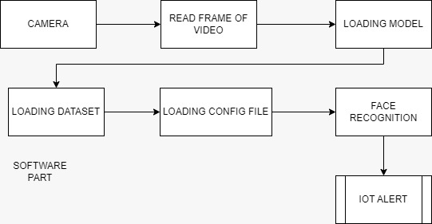
SOFTWARE BLOCK DIAGRAM OF IDS

Slide 10
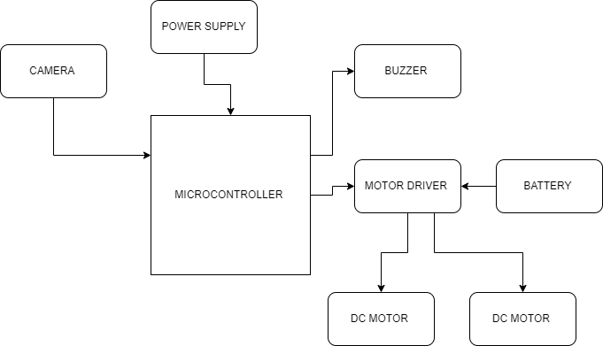
HARDWARE BLOCK DIAGRAM

Slide 11
BLOCK DIAGRAM EXPLANATION:
The camera is the input device responsible for capturing images or video footage of the monitored area.
It serves the purpose of detecting both known and unknown persons using deep learning algorithms for person identification.
The microcontroller acts as the central processing unit of the system, receiving input from the camera and making decisions based on the detected individuals.
It processes the incoming video data, executes the deep learning algorithms for person identification, and determines whether the detected person is known or unknown.

Slide 12
BLOCK DIAGRAM EXPLANATION:
The motor driver is a crucial component for controlling the movement of the regulated patrolling robots.
It interprets commands from the microcontroller and regulates the power supplied to the motors of the robots, enabling precise control over their movement.
The buzzer serves as an alerting device, generating audible signals to notify residents or security personnel of an intrusion.
It is activated by the microcontroller when an unknown person is detected, contributing to a multi-modal alerting system.

Slide 13
HARDWARE REQUIREMENT:
Motor driver
Dc motor
Battery
Microcontroller
Buzzer

Slide 14
SOFTWARE REQUIREMENT:
Python IDLE
Python
Arduino ide
Embedded c

Slide 15
ADVANTAGES
Real-Time Response
Autonomous Operation
Improved Identification Accuracy
Reduced Human Risk
Interactive Alerting
Women and Children Saftey

Slide 16
DISADVANTAGES:
Limited Coverage
Power Consumption

Slide 17
CONCLUSION:
The integration of deep learning-based person identification with regulated patrolling robots represents a significant advancement in apartment security.
By combining advanced technology with a responsive hardware framework, the proposed system offers a comprehensive solution to the challenges associated with unauthorized access.
The utilization of microcontrollers, buzzers, DC motors, and motor drives ensures not only efficient detection but also a swift and intelligent response to potential security threats.
This innovative system has the potential to redefine the landscape of residential security, providing enhanced protection for apartment dwellers against a range of security risks

Slide 18
REFERENCES
[1] S R Madkar, Vipul Mehta, Nitin Bhuwania, Maitri Parida, International Journal of Advanced Research in Computer Science and Software Engineering, Robot Controlled Car Using Wi-Fi Module, Volume 6, Issue 5, May 2016.
[2] Chinmay Kulkarni, Suhas Grama, Pramod Gubbi Suresh, Chaitanya Krishna, Joseph Antony, First International Conference on Systems Informatics, Modelling and Simulation, Surveillance Robot Using Arduino Microcontroller, Android APIs and the Internet, 2014 IEEE.
[3] Minni Mohan And Siddharth Shelly, International Journal on Cybernetics & Informatics (IJCI),Border Security Robot Vol. 5, No. 2, April 2016.
[4] Singoee Sylvestre Sheshai, f17/1454/2011, university of Nairobi department of electrical and information engineering, raspberry pi based security system, Prj index 156, 17th May, 2016.
[5] M. Peter and H. David, “Learn Raspberry Pi with Linux,” Apress, 2012
[6] Rahul Kumar, Ushapreethi P, Pravin R. Kubade, Hrushikesh B. Kulkarni, Android Phone controlled Bluetooth Robot, International Research Journal of Engineering and Technology (IRJET), Volume: 03 Issue: 04 | Apr-2016 p-ISSN: 2395-0072 © 2016, IRJET

Slide 19
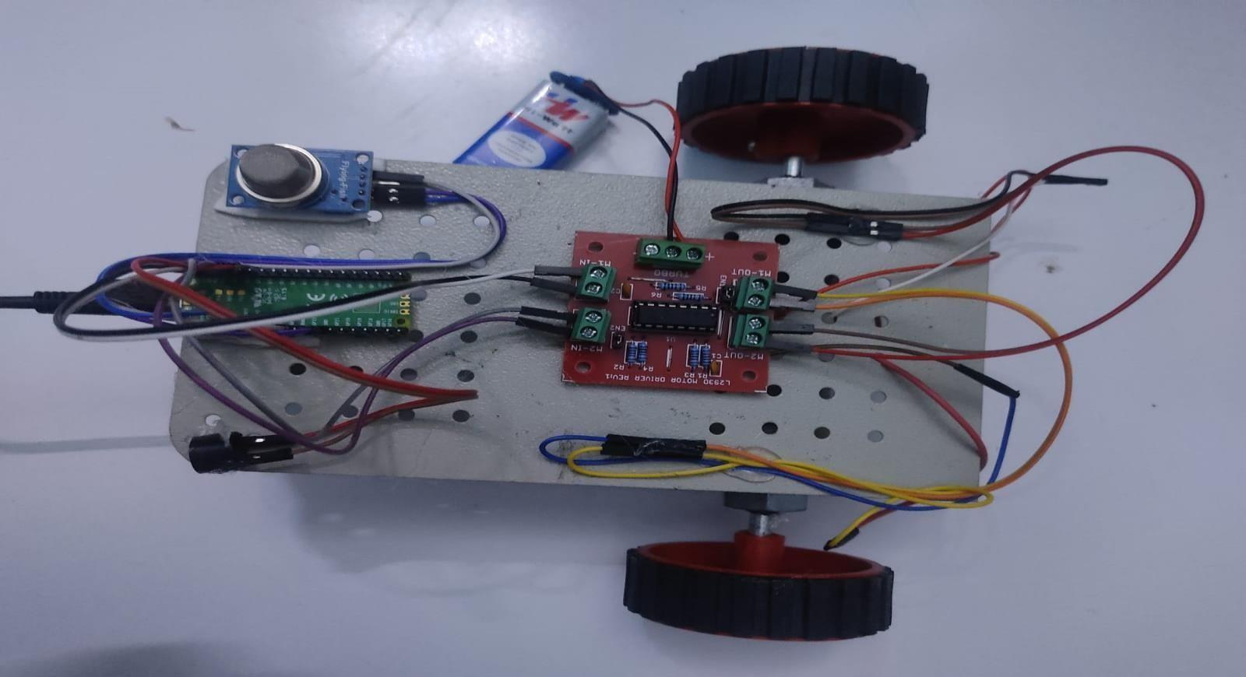
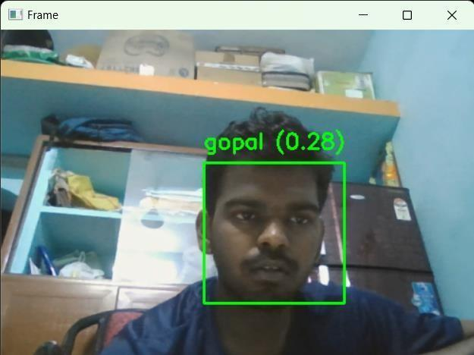
RESULTS

